Slide 1
New Barn 2023-24

Slide 2
New Barn - Main Details
Leave 24th and return on 26th.
Come to school in own clothes with bags (children have to be able to carry their bag).
First day packed lunch provided by home/school (if paid for a hot meal).
Return to school for normal end of day.
Emergency contact form returned asap.
All medicines and money to be given to staff before departure.
Emergency contact details are the school office.

Slide 3
Where is New Barn?
https://www.newbarn.co.uk/
25-30 minutes away.
We go by bus.
Photos (on Drive)

Slide 4
What do we do?
DAY/DATE | DAYTIME | EVENING
Wednesday | Arrive at New Barn Field Centre for 10:30am Fire Talk, Site Tour and ‘Meet the Animals’ Lunch (12ish) Shelter Building & Bushcraft Skills | Evening Meal at 5:00pm Pottery 6:00pm Start – (Long Ship Models) Evening/Night Walk 7:15pm
Thursday | Breakfast (7-8am) Full Day Saxon Living History 9:30am – 3:30pm Lunch break around 12ish | Evening Meal at 5:00pm Bygone Ways 7:00pm
Friday | Breakfast (7-8am) Nature Walk around New Barn Lunch (12ish) Depart New Barn at 1:30pm. Arrive back at school around 2pm

Slide 5
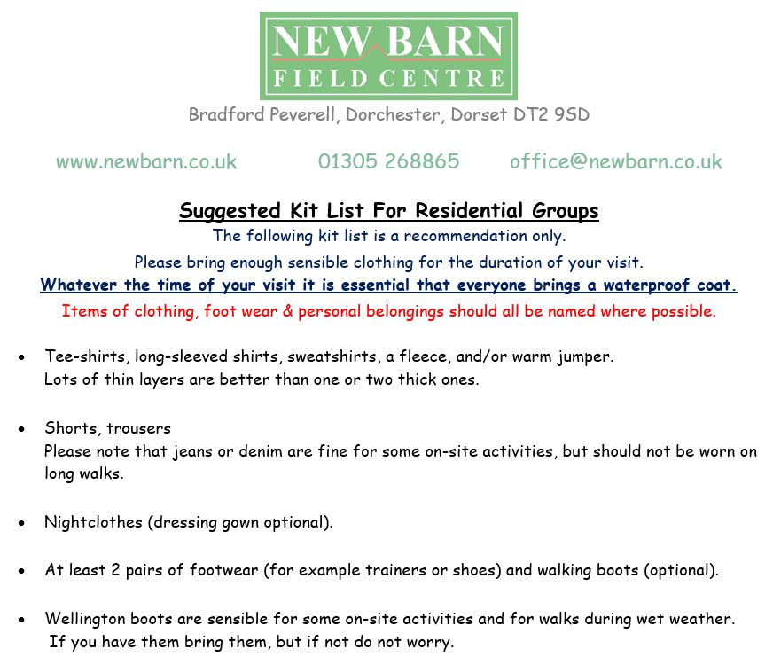
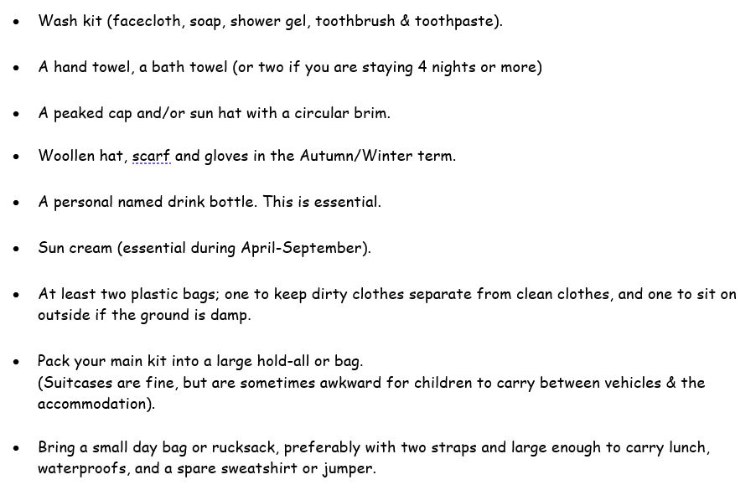
What to bring?
Don’t need:
bedding
phones
food

Slide 6
Food at New Barn
Children have chosen their lunch and evening meal options.
Lunch:
Sandwich / Sausage Roll
Crisps
Fruit
Biscuit
Drink
Evening:
Chicken nuggets and chips
Fish and chips
Breakfast:
Cereal
Toast
Cooked breakfast (sausage, egg, beans, mushrooms etc)
Please put on the form any medical or dietary needs!

Slide 7
Parent/Carer questions
Please ask anything
If you can’t think of anything now, email:
a.pickavance@smsjwool.dorset.sch.uk
office@smsjwool.dorset.sch.uk

